Slide 1
ReefRanger
By: Katharine Klugman

Slide 2
BACKGROUND
Native fish populations are vital for the overall health and functioning of coral reef ecosystems (Díaz-Pérez et al., 2016).
Invasive species pose a threat to marine ecosystems, leading to notable declines in the abundance of native species and altering ecosystem function (Albins, 2015).

Slide 3
BACKGROUND
Lionfish pose a dual threat by competing with economically and recreationally vital reef-fish species for space and food.
Their predation on juvenile individuals across various species undermines stock rebuilding efforts and poses a significant risk to reef-fish populations (Johnston et al., 2015).

Slide 4
PROBLEM
Lionfish robots currently require manual operation, and deployed traps are unintentionally capturing and harming ecologically important fish species, posing threats to coral reef health and capturing lionfish at an ineffective rate.

Slide 5
THE PROBLEM STATEMENT CANVAS
Context: Problem occurs in invaded coral reef ecosystems in the Atlantic, Gulf of Mexico, and Caribbean | Problem: Lionfish robots currently require manual operation, and deployed traps are unintentionally capturing and harming ecologically important fish species, posing threats to coral reef health and capturing lionfish at an ineffective rate. | Alternatives: Electric shock robots Spearfishing Traditional traps
Customers: Fishermen and commercial fishers Environmental conservation orgs NOAA and governmental orgs | Emotional Impact: Frustrated Stressed Overwhelmed Quantifiable impact: Time consuming Energy consuming | Alternative Shortcomings: Bycatch Lionfish escape Manual operation Not killing them as fast as reproduction rates

Slide 6
SOLUTION
ReefRanger employs species recognition software to specifically target Lionfish, capturing them in an underwater trap through an automated process.

Slide 7
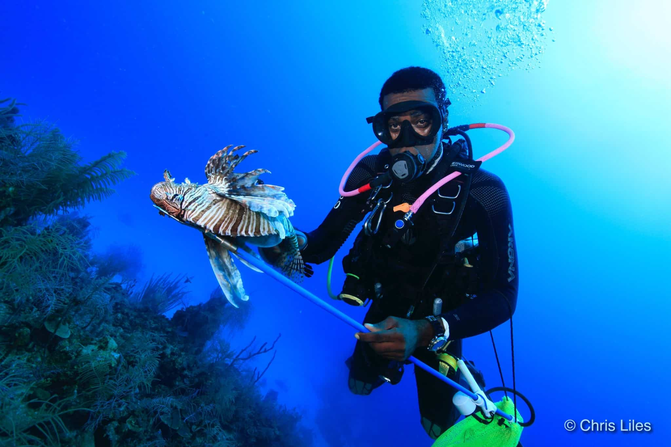
CURRENT SOLUTIONS
Spearfishing
Not a feasible solution on a large scale.
Lionfish populations have high reproductive rate, invasive range, camouflage abilities, are venomous.
The resource-intensive nature of large-scale spearfishing campaigns makes them impractical for sustained and effective control.

Slide 8
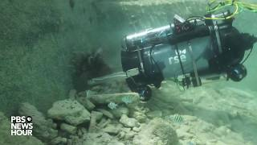
CURRENT SOLUTIONS
Robots
Not a feasible solution on a large scale.
Robot is user operated and can stun lionfish using electric shocks and bring them back to the surface.

Slide 9
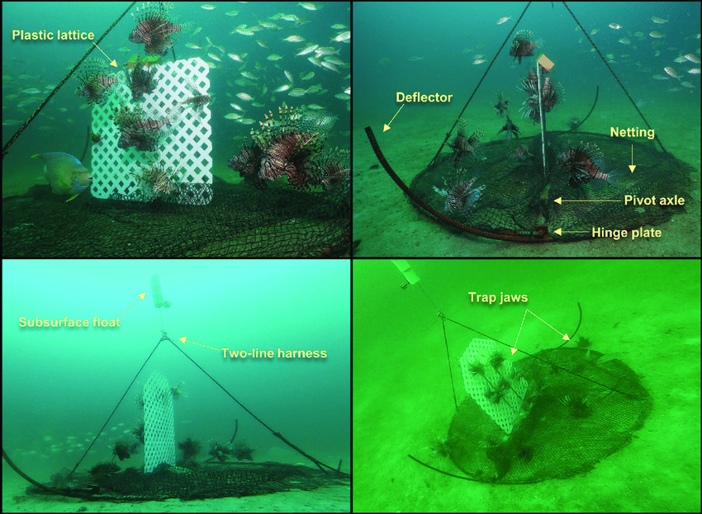
CURRENT SOLUTIONS
Traps
Bycatch of other species is huge issue

Slide 10
Value Proposition Canvas

Slide 11
Pain Killers
Gain Creators
Solution
ReefRanger employs species recognition software to specifically target Lionfish, capturing them in an underwater trap through an automated process.
Traps unintentionally capture and harm ecologically important fish species.
Current robots require manual operation
Lionfish escape from current traps
Advanced species recognition software, minimizing bycatch
Automated process improves efficiency and reduces labor costs
Motorized entrance/exit that prevents fish escaping

